Slide 1
Charity Management System

Slide 2
Context Level Diagram

Slide 3
Zero Level Diagram

Slide 4
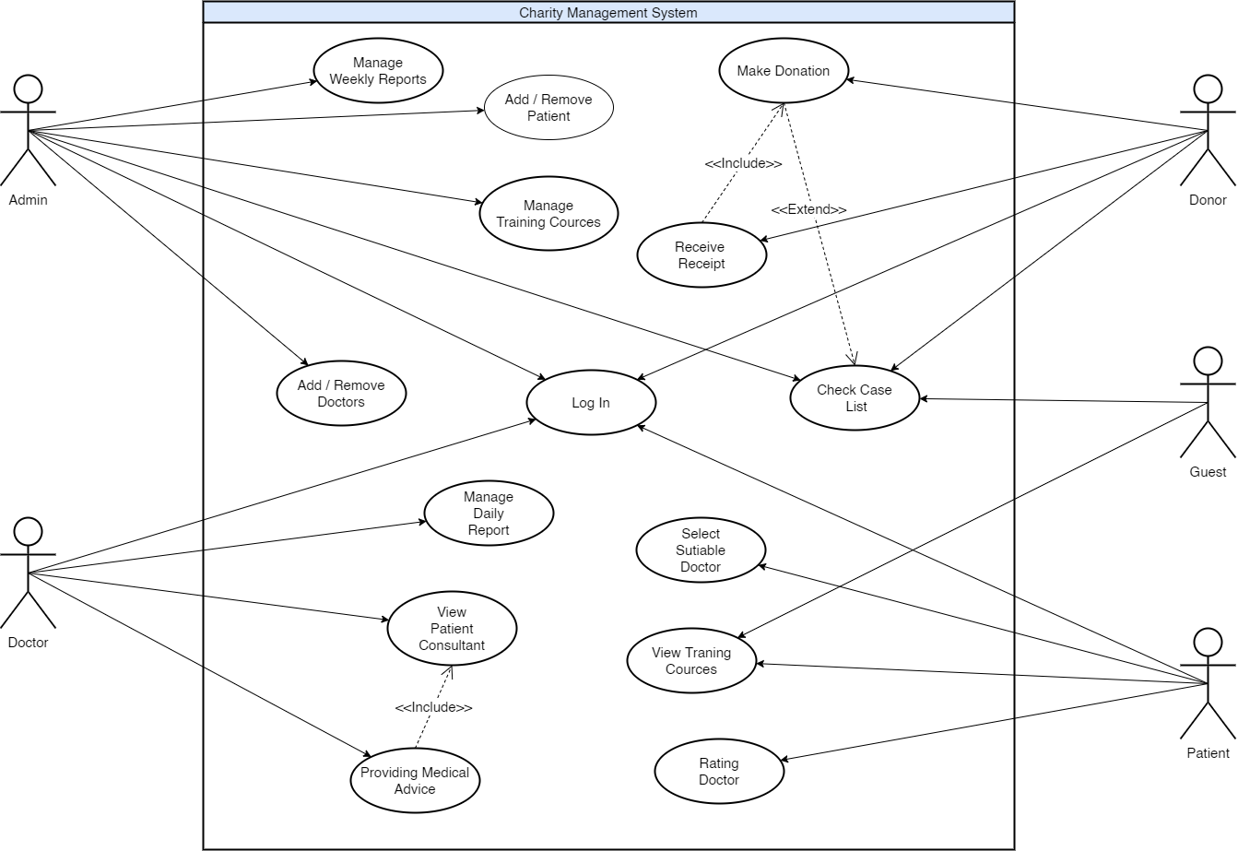
Use Case Diagram

